Slide 1
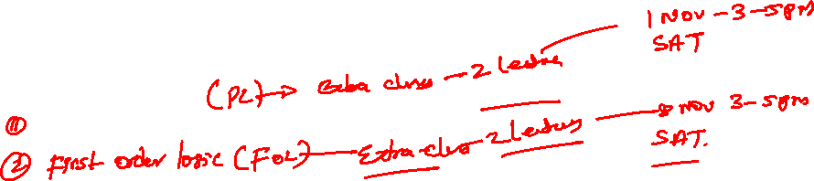
Logical Agents
Propositional Logic
Prof. Tarachand Amgoth

Slide 2
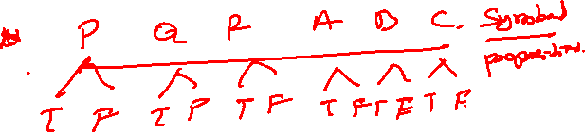
Propositional Logic
What is Propositional Logic?
Propositional logic (PL) is a formal system in logic that deals with propositions which can either be true or false.
Used in AI for reasoning about facts that can be either true or false.

Slide 3
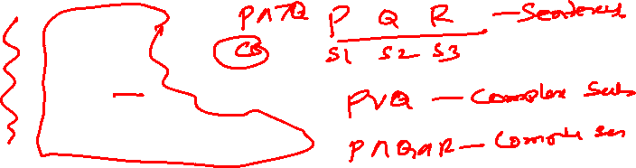
Syntax of Propositional Logic
Syntax refers to the formal rules that govern how propositions and connectives can be combined to form valid logical expressions, also known as well-formed formulas (WFF).
A syntactically correct expression follows the rules of the logic system.
  Propositions: Variables that represent statements (e.g., P, Q, R).
  Logical Connectives:
    AND ( ∧ )
    OR ( ∨ )
    NOT ( ¬ )
    IMPLIES ( → )
    IFF (If and Only If) ( ↔ )

Slide 4
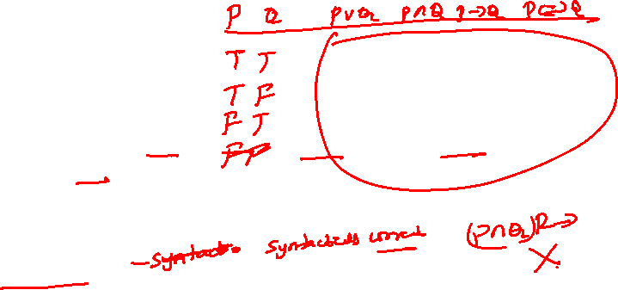
Syntax of Propositional Logic
Syntax refers to the formal rules that govern how propositions and connectives can be combined to form valid logical expressions, also known as well-formed formulas (WFF).
A syntactically correct expression follows the rules of the logic system.
Propositional Variables: Denoted by uppercase letters such as P, Q, R, representing basic propositions.
Logical Connectives: AND ( ∧ ), OR ( ∨ ), NOT ( ¬ ), IMPLIES ( → ), and BICONDITIONAL ( ↔ ).
Parentheses: Used to group expressions and define the order of operations (precedence).
Example: (P ∧ Q) → R

Slide 5
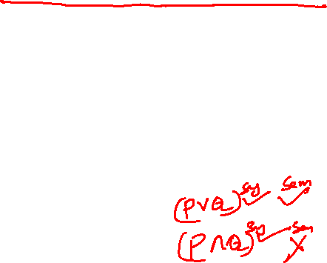
Semantics of Propositional Logic
Semantics refers to the meaning of propositional logic expressions. It determines the truth value of propositions and logical expressions based on their components.
While syntax defines the structure, semantics tells us what these structures mean in terms of truth.
Truth Assignment: Each proposition in propositional logic is assigned a truth value, either True (T) or False (F).
Truth values are used to evaluate the overall truth of compound propositions based on the connectives.

Slide 6
Semantics of Propositional Logic
Semantics refers to the meaning of propositional logic expressions. It determines the truth value of propositions and logical expressions based on their components.
While syntax defines the structure, semantics tells us what these structures mean in terms of truth.
Example of Semantic Evaluation: Given the following truth assignments:
  P = True, Q = False, R = True.
Evaluate the formula: (P ∧ ¬Q) → R
  Step 1: ¬Q = True (since Q = False).
  Step 2: P ∧ ¬Q = True ∧ True = True.
  Step 3: (P ∧ ¬Q) → R = True → True = True.

Slide 7
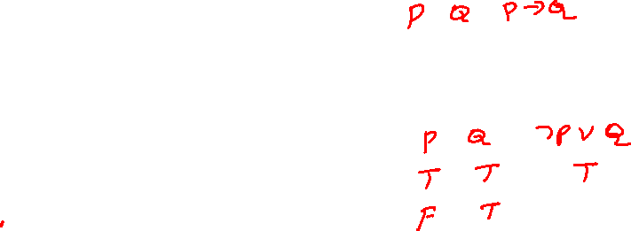
A Simple Knowledge Base
Knowledge Base (KB): A set of sentences in propositional logic used to represent facts about the world.
Example of KB:
  P→Q (If it rains, the ground is wet)
  P (It is raining)
  Goal: Use inference to determine if Q is true.

Slide 8
A Simple Inference Procedure
Definition: Inference is the process of deriving new sentences from existing ones.
Modus Ponens:
  Rule: If P→Q and P are true, then Q is true.
  Example:
    Premise 1: P→Q
    Premise 2: P
    Conclusion: Q

Slide 9
Model Checking
What is Model Checking?: Model checking verifies whether a given system or model satisfies certain properties. It systematically explores all possible states of the system to ensure that the property holds in every state.
Example Scenario: System: Consider a simple system where:
  P: "It is raining."
  Q: "The ground is wet."
Property to Check: We want to verify if the system always satisfies P → Q (If it is raining, the ground must be wet).

Slide 10
Model Checking
What is Model Checking?: Model checking verifies whether a given system or model satisfies certain properties. It systematically explores all possible states of the system to ensure that the property holds in every state.
Analysis of the Truth Table: Row 1: When P = True and Q = True, the implication P → Q is True (the system satisfies the property).
Row 2: When P = True and Q = False, the implication P → Q is False (the system fails to satisfy the property).
Row 3: When P = False and Q = True, the implication P → Q is True (because the premise is false, the implication holds).
Row 4: When P = False and Q = False, the implication P → Q is True (again, because the premise is false, the implication holds).

Slide 11
Propositional Theorem Proving
Definition: Theorem proving involves determining whether a given statement can be derived from the knowledge base using logical rules.
Without consulting Model checking

Slide 12
Concepts for Propositional Theorem Proving
Logical Equivalence
Validity
Tautologies
Satisfiability

Slide 13
Logical Equivalence
What is Logical Equivalence?:Two logical statements are logically equivalent if they have the same truth value in every possible truth assignment.
Denoted as: P ≡ Q, which means that P and Q are equivalent.
Logical equivalence allows us to replace one expression with another in a logical formula without changing its truth value.

Slide 14
Tautology and Contradiction
A tautology is a formula or logical statement that is always true, regardless of the truth values of the individual propositions involved.
Denoted as ⊤.
Example: P ∨ ¬P (either P is true. or P is false, making the statement always true).
A contradiction is a formula or logical statement that is always false, no matter what truth values the individual propositions take.
Denoted as ⊥.
Example: P ∧ ¬P (a proposition cannot be both true and false at the same time).

Slide 15
Satisfiability and Validity
Satisfiable: A formula is satisfiable if there is at least one assignment of truth values to the variables that makes the formula true.
Valid: A formula is valid if it is true under all possible truth assignments (i.e., a tautology).
Example:
The formula P ∨ ¬P is always true, making it a valid formula (tautology).

Slide 16
Inference and Proofs
What is Inference in Propositional Logic?:Inference is the process of deriving new conclusions from existing premises using logical rules.
In propositional logic, inference allows us to establish whether a statement follows logically from others, using inference rules like Modus Ponens and Modus Tollens.
The goal of inference is to make valid conclusions based on known facts or axioms.

Slide 17
Inference and Proofs
Example of an Inference and Proof:
Premises:
  P → Q: If it is raining, the ground will be wet.
  Q → R: If the ground is wet, the grass will grow.
  P: It is raining.
Proof:
  From P → Q and P, we infer Q (the ground is wet) using Modus Ponens.
  From Q → R and Q, we infer R (the grass will grow) using Modus Ponens.
  Conclusion: The grass will grow (R).

Slide 18
Inference and Proofs
What is Modus Tollens?:Modus Tollens is a fundamental inference rule in propositional logic.
It allows us to infer the negation of a premise from a conditional statement and the negation of its conclusion.
Structure:
  If P → Q (If P, then Q).
  ¬Q (Q is false).
  Conclusion: ¬P (Therefore, P must be false).

